Slide 1

Computational Physics
Lesson 6 – More Monte Carlo Methods

Slide 2
Learning Objectives
Appreciates that there are a variety of techniques in computational modelling.
Understands basic applications of monte-carlo methods
Implements simple monte-carlo methods

Slide 3
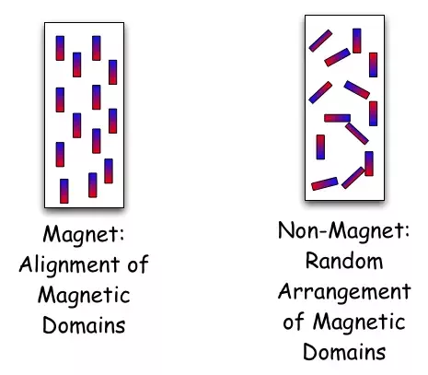
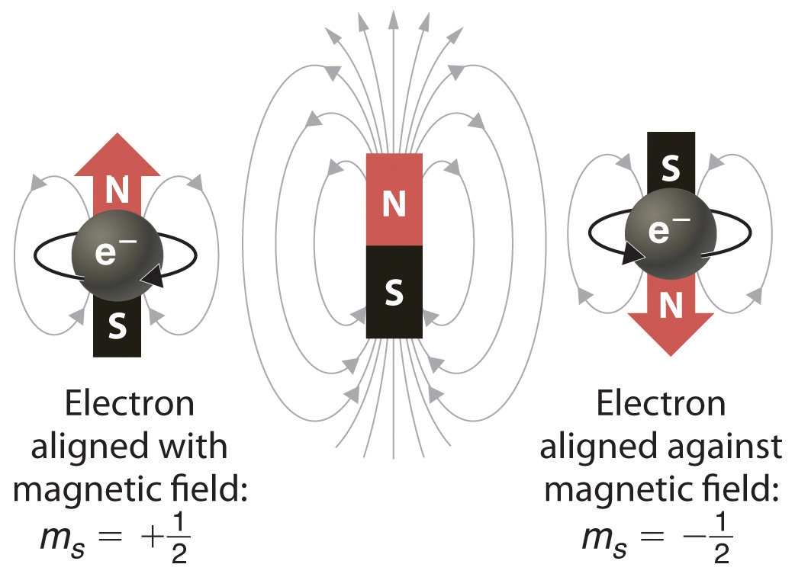
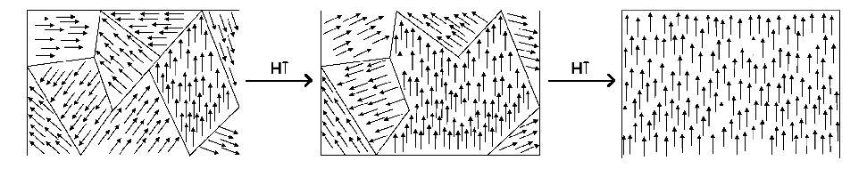
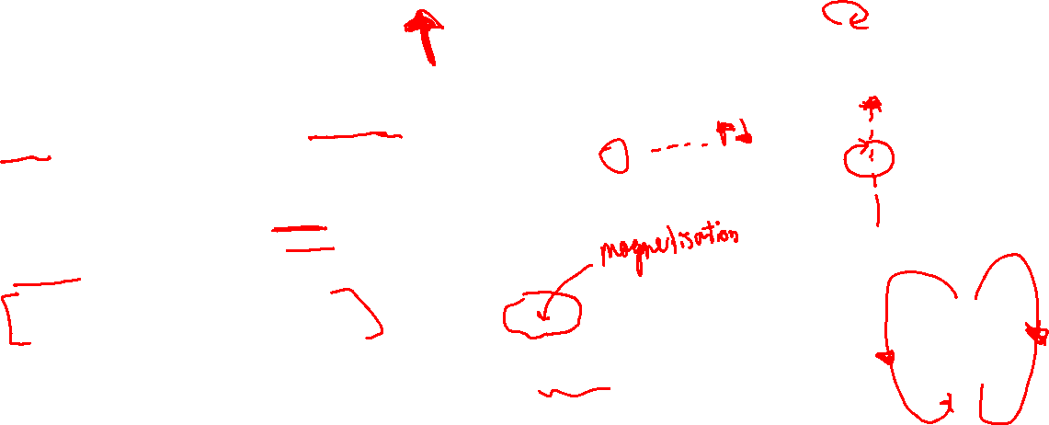
Ising Model – How magnets work
Note: You’ll have to take a lot of this on faith. I want to show you a proper application of computational physics.
Each atom in a solid has a “spin” which means that it behaves like a small magnet.
Spins close to each other line up, resulting in magnetised “domains”.
When many of these domains align, the material is a magnet (has a net magnetic field).

Slide 4
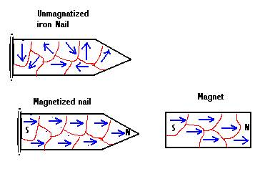
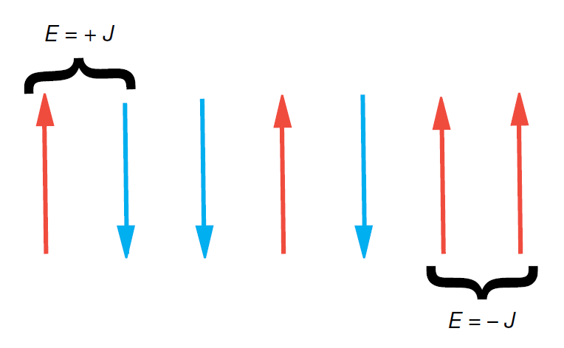
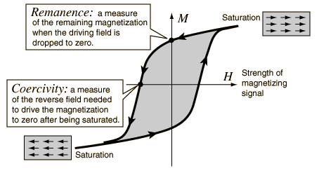
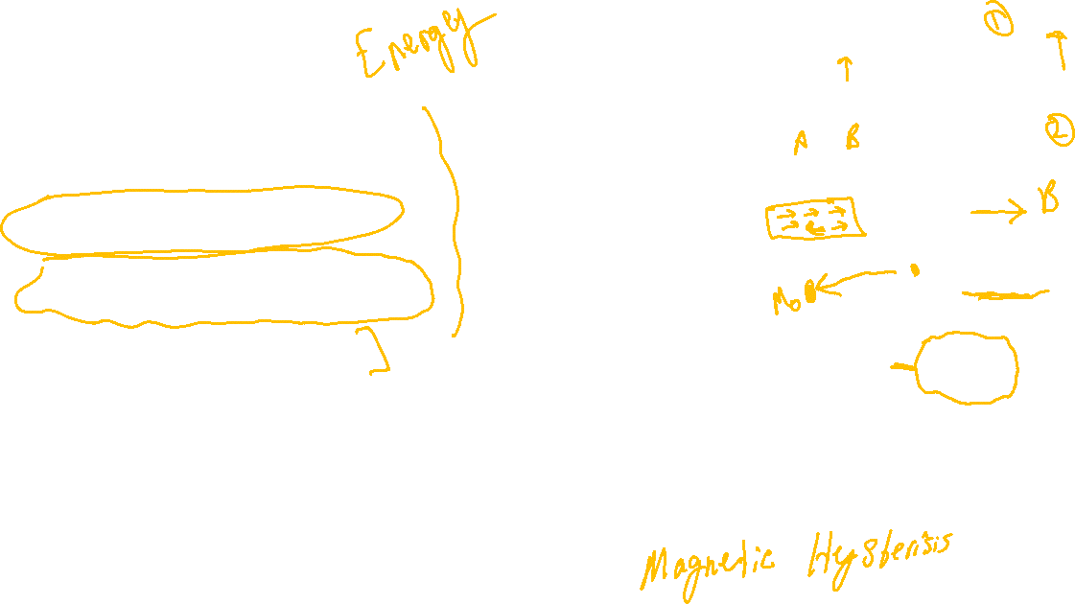
Ising Model – How magnets work
We can consider the energy associated with each atomic spin:
Spins that line up with each other have a lower energy.
Spins that line up with an external magnetic field have a lower energy.
Domains are formed due to energy minimisation.
Permanent magnets become magnetised in response to an external magnetic field, and then remain magnetised after the field is removed

Slide 5
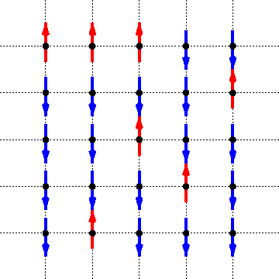

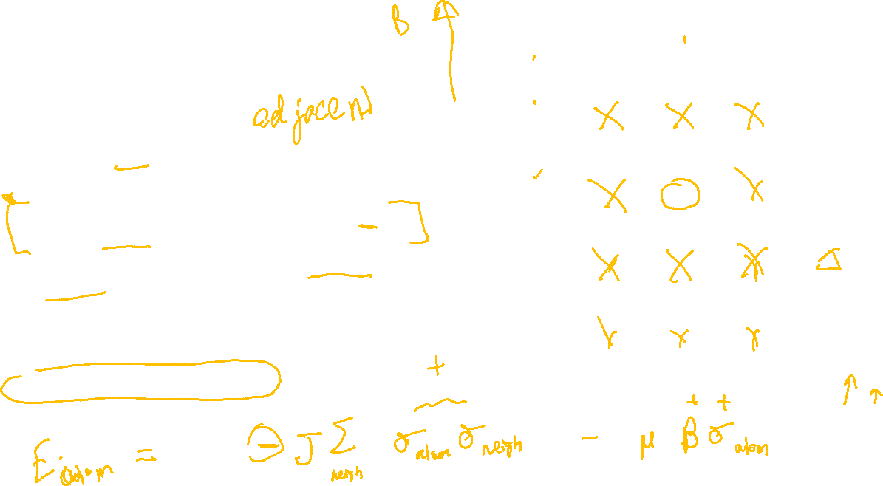
Ising Model
Consider a grid (or chain, or lattice) of atoms.
The external magnetic field is in the up direction.
Each atom’s spin ($σ_{i}$) can either be up ($σ_{i}=+1$) or down ($σ_{i}=−1$).
Consider interactions only between spins that are next to each other.
Energy of one atom is $E_{i}=−{J ∑}_{j in neighbours} σ_{j}σ_{i}−μσ_{i}B$. ($J$and $μ$) are constants.
Total energy is $E=\sum_{all spins}{E_{i}}$

Slide 6

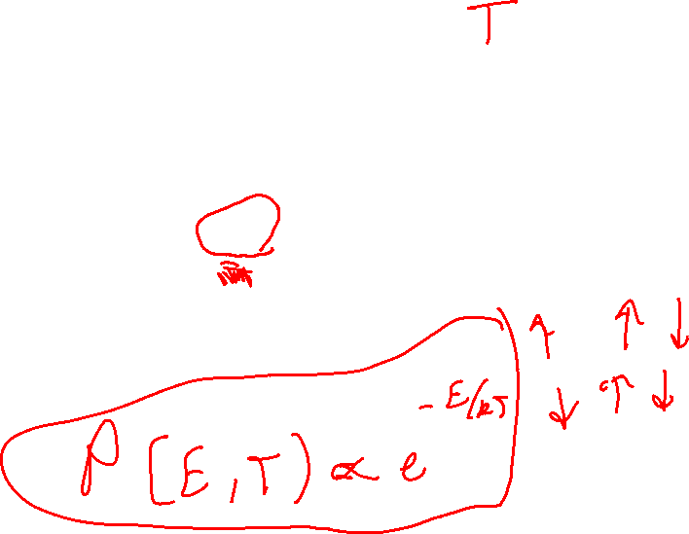
Ising Model – Statistical Mechanics
Spins are always randomly flipping, so the state of the system is always changing (similar to a gas where atoms are always colliding).
The probability of finding the system in a state depends only on the energy of that state and the temperature. It is $P\left(E, T\right)=\frac{e^{−\frac{E}{kT}}}{Z(T)}$, where $Z\left(T\right)=\sum_{all possible energies}{e^{−E/kT}}$.
$Z(T)$ is called the partition function, but won’t matter for us.
$k$ is the Boltzmann constant.

Slide 7

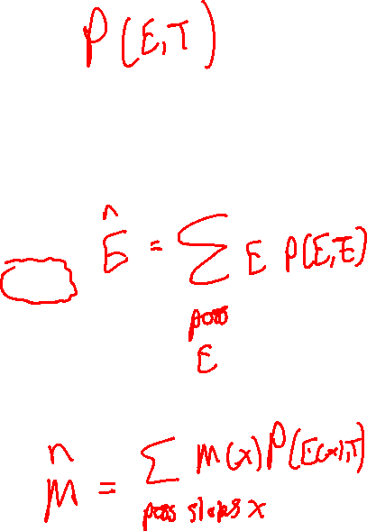
Ising Model – Statistical Mechanics
In principle, if we know $Z(T)$, then we know the probability of any state, and we can take an average over all states to determine any physical quantity (for example, magnetisation).
In practice, it is very hard to write down an expression for $Z\left(T\right)$
It has been done in 1D and 2D with nearest-neighbour interactions.

Slide 8

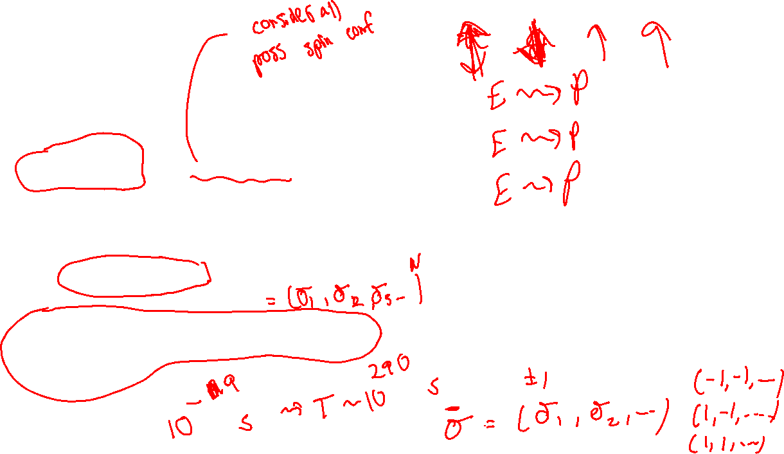
Naïve Simulation Idea
$P\left(E, T\right)=\frac{e^{−\frac{E}{kT}}}{Z(T)}$, so just randomly sample all the states and then take an average.
But there are $2^{N}$ states (with N atoms). This is a really big number if the number of atoms is realistic. E.g. $2^{1000}=1.1×{10}^{301}$
Also, many of these states have a low probability, so we’d be wasting a lot of time looking at states that don’t matter.

Slide 9

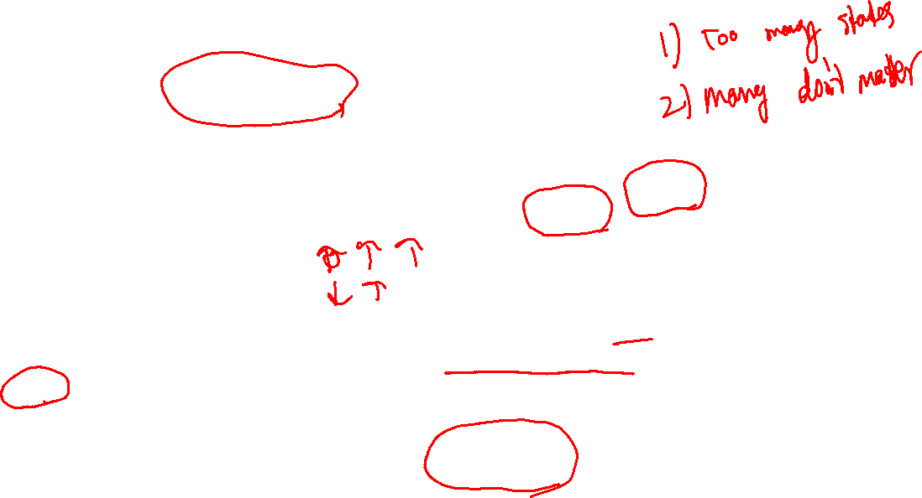
Metropolis-Hastings Algorithm
Key idea: it’s a way to sample each state with probability $P\left(E, T\right)=\frac{e^{−\frac{E}{kT}}}{Z(T)}$
How to do this?
Pick a starting configuration (spins) and calculate its energy $E$.
Pick a related configuration by randomly changing some spins. Compute its energy, $E^{′}$
Make a random choice to accept the new configuration or keep the old one. You should choose to change with probability $p=\frac{P\left(E^{′}, T\right)}{P(E, T)}$

Slide 10
Example

Slide 11
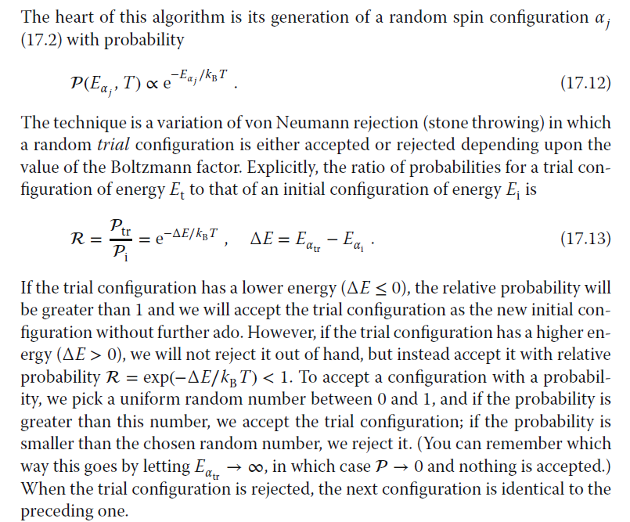
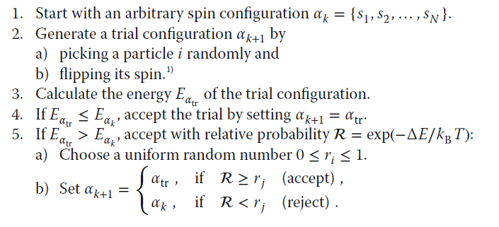
Metropolis-Hastings Algorithm – Details (see Landau textbook p414)

Slide 12
Further Reading
https://tanyaschlusser.github.io/posts/mcmc-and-the-ising-model/
http://stanford.edu/~jeffjar/statmech2/intro4.html
Original papers. These are obviously tricky, but worth looking at (see “Files”).
Landau textbook section 17.4 (see “Files”)

